Slide 1

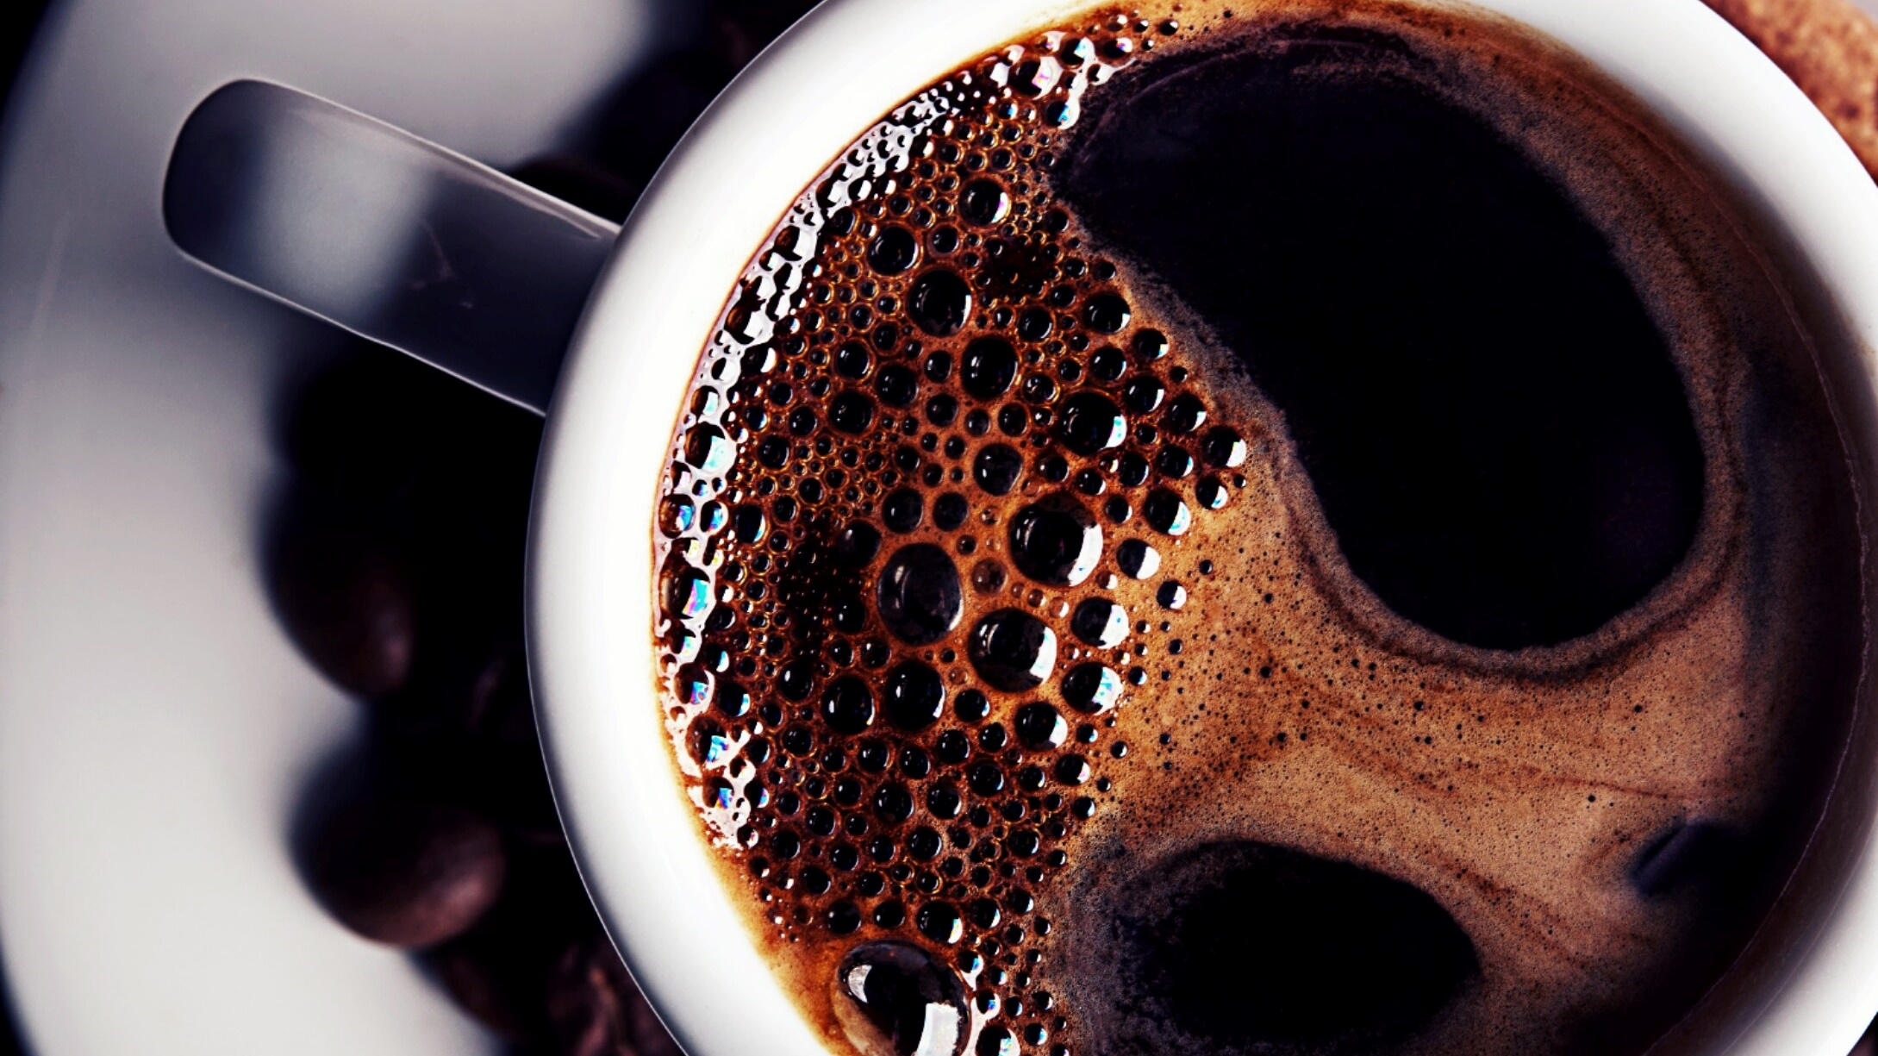
Bright Coffee Shop Sales Analysis
- October, 2025

Slide 2

Bright Coffee Shop Objective
WHICH PRODUCTS GENERATE THE MOST REVENUE
What time of day the store performs best
Sales trends across products and time intervals
Recommendations for improving sales performance

Slide 3

WHICH PRODUCTS REVENUE GENERATE THE MOST REVENUE
Coffee and tea contribute the highest revenue

Slide 4
What time of day the store performs best(1/2)
Our sales show that people buy the most Barista Espresso, Brewed Chai Tea, Gourmet Brewed Coffee, and Hot Chocolate across all the time of the day especially in the morning, which means we should focus on morning operations. This includes making sure we have enough staff, keeping popular products stocked, and running morning specials to boost sales during that key time.

Slide 5
What time of day the store performs best(2/2)
During the evening, sales drop significantly compared to the busy morning rush. This provides an opportunity to increase business during these slower periods.
In other words: Evening sales are much lower than morning sales. This slow period is a chance to try new ideas to bring in more customers and make more money.

Slide 6
Sales trends across products and time intervals(1/2)
Over the last six months, transactions have been consistently growing. Total sales have more than doubled, increasing by about 102% from the first month to the sixth. Even with a minor setback in February, the overall performance shows the business is improving its earnings and attracting more customers over time.

Slide 7
Sales trends across products and time intervals(2/2)
According to the sales chart, coffee and tea are the most popular items sold throughout the entire day. However, sales of these drinks are at their highest in the morning, especially for coffee.

Slide 8
Product Performance(1/2)
Weekdays generate the most Revenue
Top Selling Product
Notes:
Revenue data from all stores shows that weekdays are the busiest and bring in the most money, likely because of regular customers like commuters and office workers.
The five product types that bring in the most sales are:
1.Coffee 2.Tea 3.Bakery items 4.Drinking chocolate 5.Coffee beans
Since these items account for most sales, it's important to keep them high-quality and available, and to run special promotions for them.

Slide 9
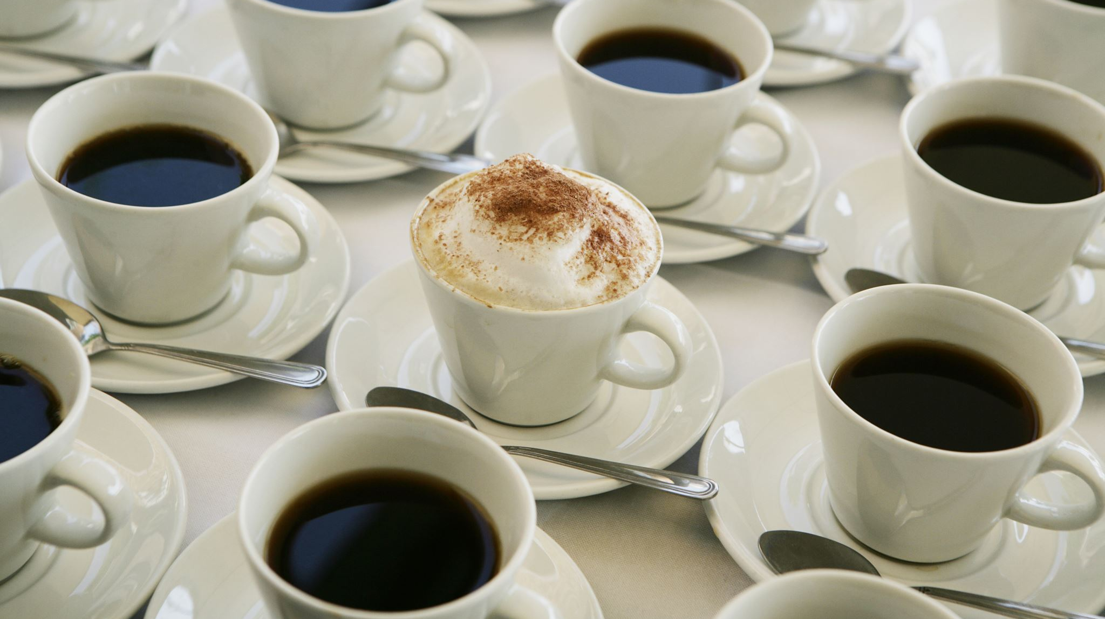
Product Performance(2/2)
Revenue data from all stores shows that weekdays are the busiest and bring in the most money, likely because of regular customers like commuters and office workers.
The five product types that bring in the most sales are:
1.Coffee
2.Tea
3.Bakery items
4.Drinking chocolate
5.Coffee beans
Since these items account for most sales, it's important to keep them high-quality and available, and to run special promotions for them.

Slide 10
Location Distribution(1/2)
Hell’s kitchen is generating most of the revenue.

Slide 11
Location Distribution(2/2)
In the past six months, the business has seen a strong increase in overall revenue, with all three stores contributing to consistent growth.

Slide 12
Recommendations for improving sales performance
Make the most of the morning rush:
Since the mornings are your busiest time, make sure you have enough staff and product to meet the high demand.
Offer special breakfast promotions or rewards for your early customers.
Get more evening customers:
Try attracting more people in the evening by offering "Happy Hour" specials.
You could also add new products like cold beverages or desserts to the menu.
Highlight the best products:
Put more focus on promoting your top-selling items, such as Espresso,
Brewed Chai Tea, and Gourmet Brewed Coffee, both in the store and in your marketing.
Look into the February dip:
Investigate why sales dropped in February and create targeted campaigns or special seasonal offers to
prevent it from happening again.

Slide 13
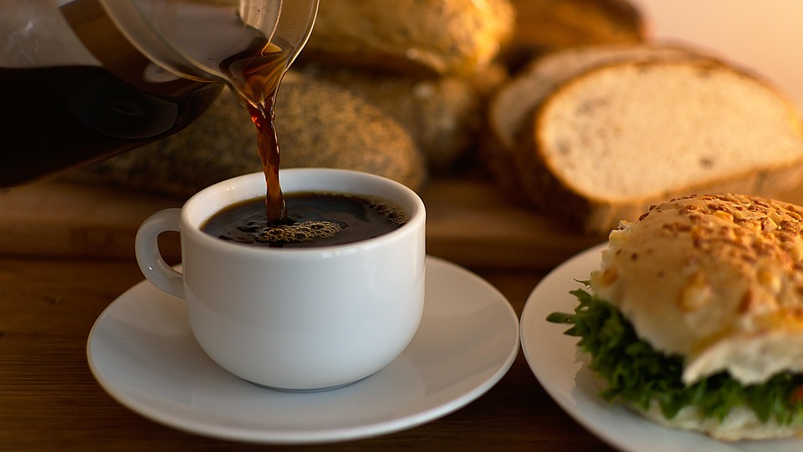
THANK YOU
Phindile Mnisi

